Slide 1
CS7/8745 : Machine Learning Instructor: Salim Sazzed Department of Computer Science University of Memphis

Slide 2
Convolutional Neural Network (CNN)

Slide 3
Convolutional Neural Network (CNN)
CNN is a type of artificial neural network designed for processing structured grid data, particularly suited for tasks involving visual imagery, such as image classification, object detection, and image generation.
CNNs are inspired by the organization of the animal visual cortex and are highly effective at capturing hierarchical patterns and features in data.

Slide 4
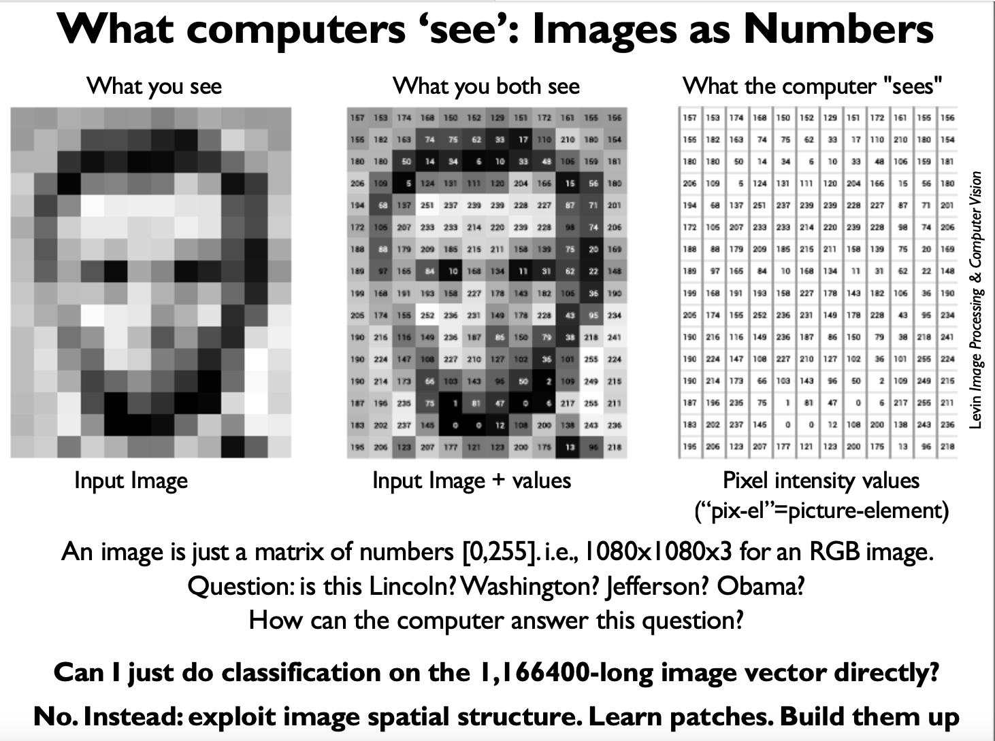

Slide 5
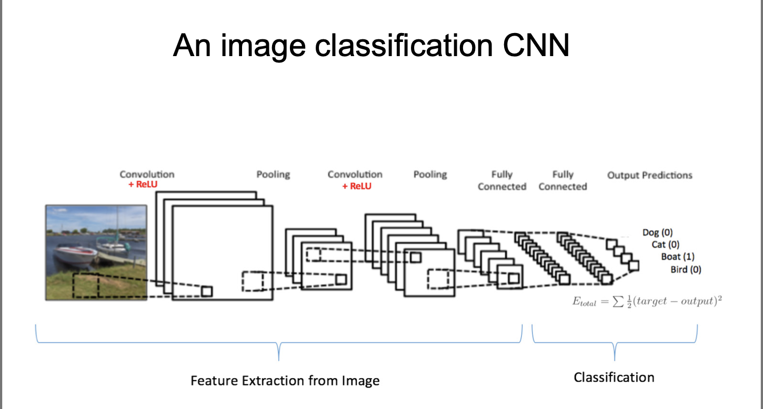

Slide 6
Main components:
Convolutional Layers: These layers apply convolutional operations to the input data using learnable filters or kernels.
Activation Functions: Activation functions, typically ReLU (Rectified Linear Unit), are applied
Pooling Layers: Pooling layers are used to reduce the spatial dimensions of the feature maps produced by convolutional layers.
Fully Connected Layers: These layers are traditional neural network layers where each neuron is connected to every neuron in the previous and subsequent layers
Dropout: Dropout prevents overfitting by randomly dropping a certain percentage of neurons during training.
Loss Function:

Slide 7
Spatial structure for image recognition

Slide 8
Spatial structure in the context of image recognition refers to the arrangement and organization of visual elements (objects or features) within an image.
It is a fundamental concept in computer vision and image processing, and it plays a crucial role in understanding and recognizing objects or patterns within images.

Slide 9
Spatial Structure for Facial Recognition System
Facial Landmarks: Facial landmarks are specific points or features on the face, such as the eyes, nose, mouth, and corners of the mouth.
Pose and Orientation: The orientation and pose of the face within the image are vital spatial structures.
Face-to-Eye Distance: The distance between the centers of the eyes, known as the interocular distance, is a critical spatial structure. It is often used as a reference point for aligning and comparing faces.
Texture and Wrinkles: Fine-grained details, such as wrinkles, moles, or skin texture, can also be considered spatial structures within a face. These details can be used to enhance the accuracy of face recognition.
Hair and Accessories: Spatial structures may include elements like hairstyle, glasses, or facial hair, which can change the appearance of the face.

Slide 10
Spatial structure can encompass both local and global aspects, depending on the context and the level of detail
Local Spatial Structure: The organization and patterns of visual elements in a relatively small or localized region of an image.
It involves analyzing and understanding the relationships between nearby pixels or features within that region.
For example, when detecting edges or corners in an image, local spatial structure within those regions.

Slide 11
Global spatial structure, on the other hand, pertains to the overall arrangement and relationships of visual elements across the entire image or a larger portion of it.
It involves understanding how objects or features are positioned relative to each other on a broader scale.
For example, in scene understanding, recognizing the spatial structure may involve identifying the layout of objects in a room or the arrangement of buildings in a cityscape.

Slide 12

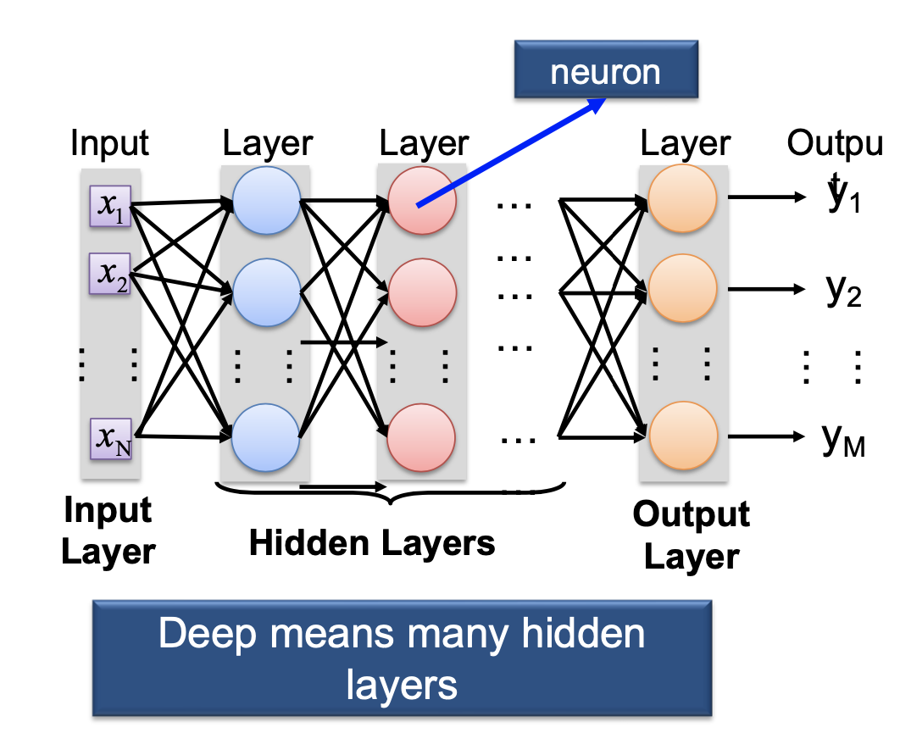
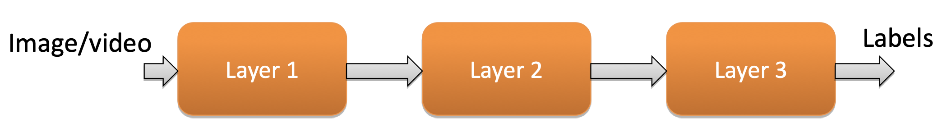
Learning a Hierarchy of Feature Extractors
Transition from local to global spatial structure detection is a consequence of the hierarchical nature of deep neural networks.
Information extracted in earlier layers is gradually combined and refined in subsequent layers, allowing the network to learn increasingly complex representations of the input data.

Slide 13
Earlier Layers (Low-Level Features): Neurons in the initial layers of a CNN are responsible for detecting simple and local patterns or features. These patterns might include edges, corners, textures, and basic shapes. The receptive fields of neurons in these layers are relatively small, allowing them to focus on fine-grained details within the input data.
Intermediate Layers (Mid-Level Features): As you move deeper into the network, neurons in intermediate layers start to capture more complex local spatial structures. They may detect combinations of low-level features and begin to recognize specific parts of objects or patterns. These neurons have larger receptive fields compared to earlier layers, allowing them to capture more context.

Slide 14
Later Layers (High-Level Features): Neurons in the later layers, especially in fully connected layers or higher-level convolutional layers, tend to focus on capturing more abstract and global spatial structures.
They may represent higher-level concepts, such as object parts, object configurations, or even entire objects. These neurons have even larger receptive fields and can capture spatial relationships between different parts of the input

Slide 15
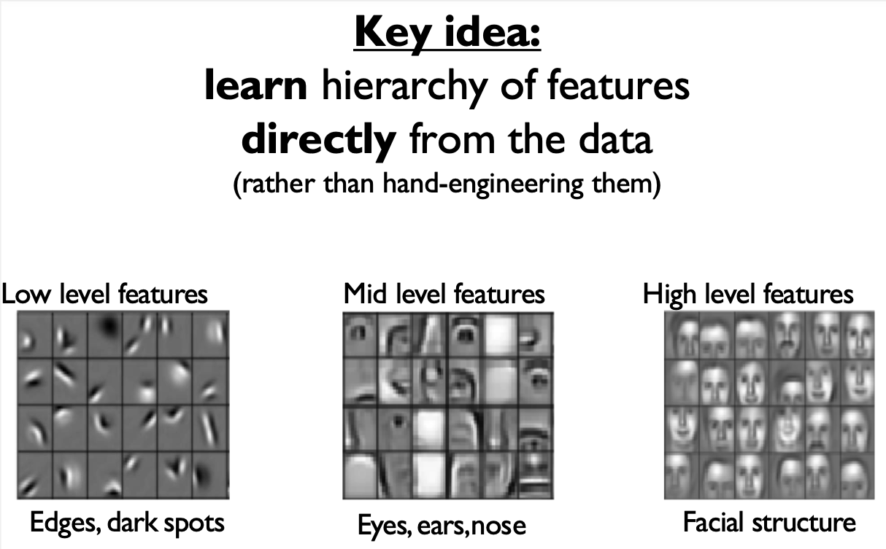

Slide 16
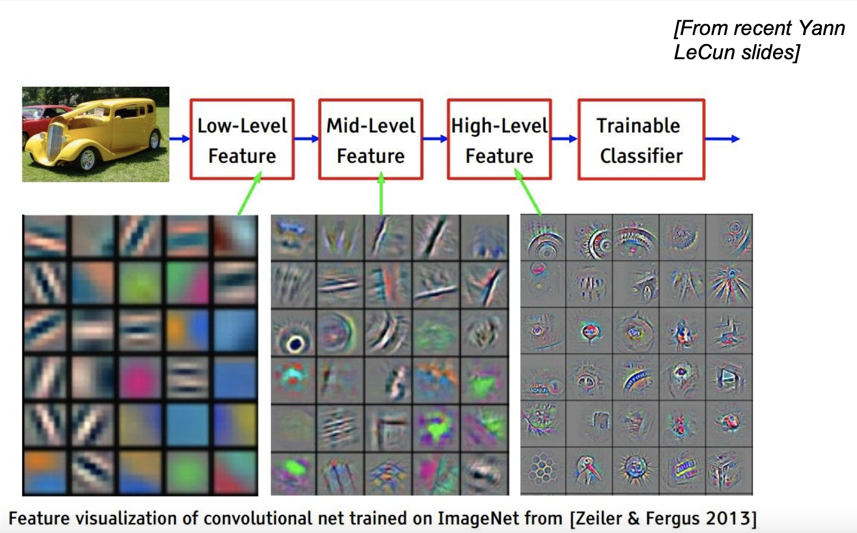

Slide 17
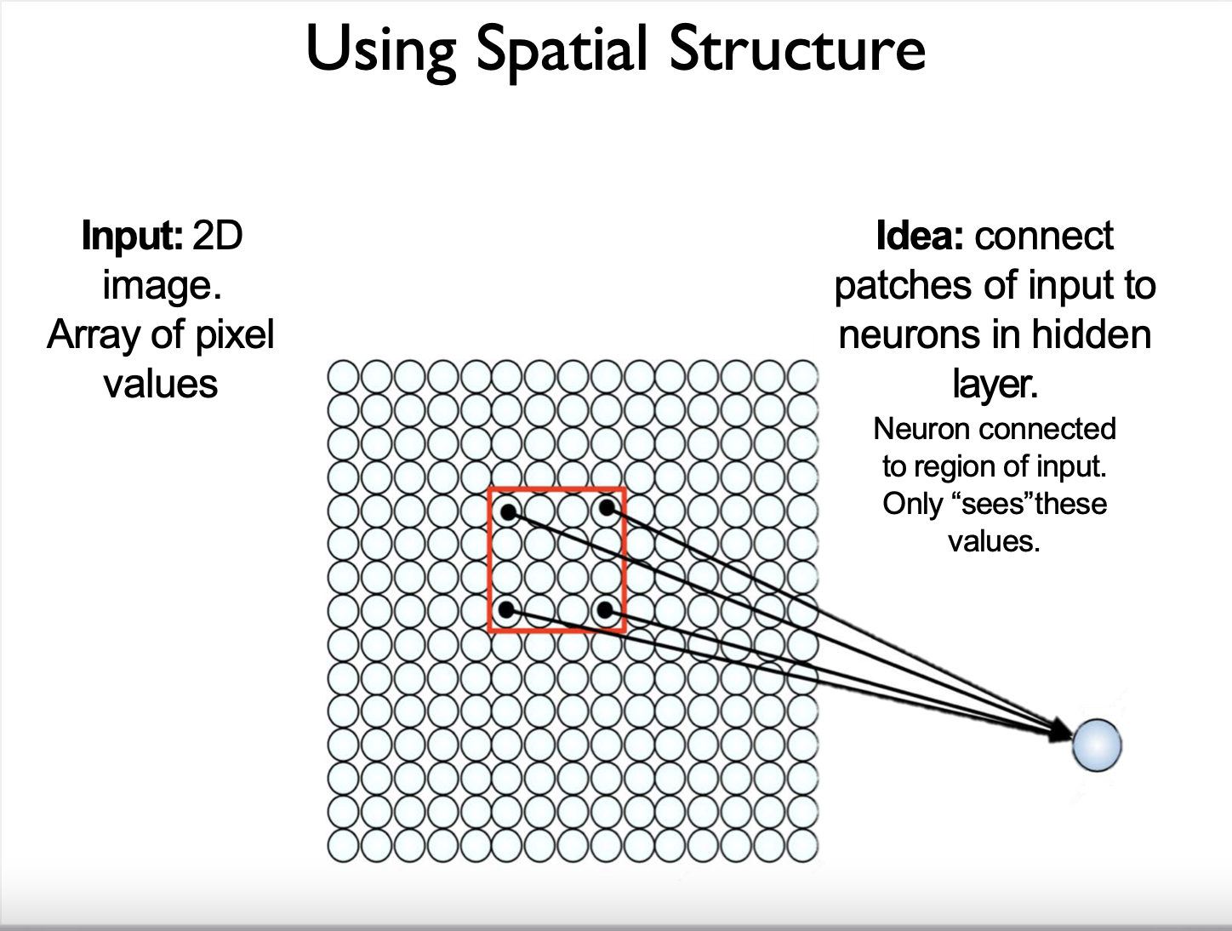

Slide 18
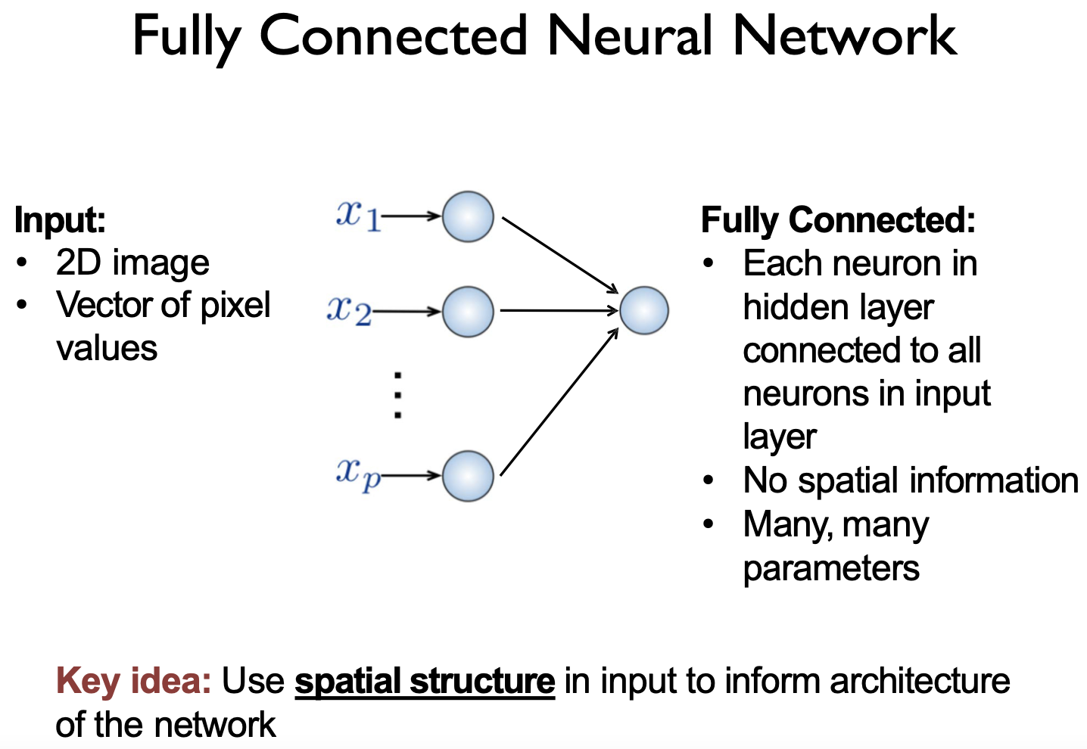

Slide 19
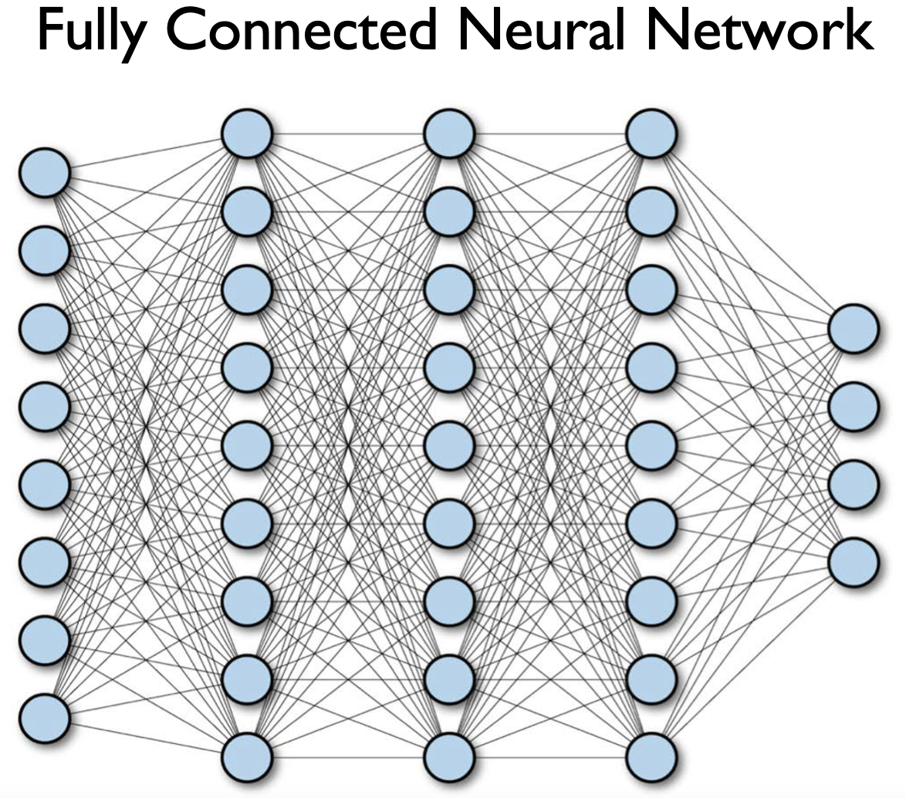

Slide 20
How many weights we can have for a fully connected layers with 1000 X 1000 input image with 1000 neurons (just a single layer)?
We will have 1000 * 1000 * 1000 = 1,000,000,000 = 10⁹ parameters = 1 billion parameters for a single layer

Slide 21
Why non-fully connected layer used in most part of the network?
Parameter Efficiency:
Fully connecting every input neuron to every output neuron in a traditional feedforward neural network results in a huge number of parameters.
Convolutional layers use shared weights (the same filter is applied to multiple regions of the input), which drastically reduces the number of parameters.
Spatial Locality:
Neighboring pixels or regions in the input data are highly correlated and contain meaningful information
Translation Invariance:
A filter can detect a specific pattern or feature in different parts of the input. For example, if a filter learns to detect a horizontal edge in an image, it can find that edge anywhere in the image.

Slide 22
Filters, Convolutions, Feature (activation) map

Slide 23
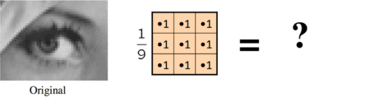
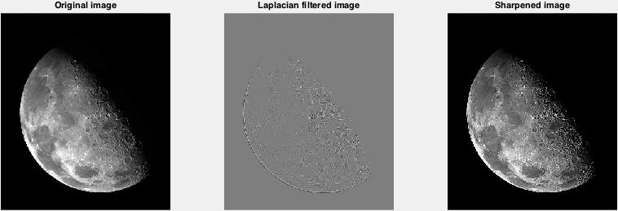
Image Blurring Filter
Classical Image Processing Filters
Image Sharpening
0 | -1 | 0
-1 | 4 | -1
0 | -1 | 0
Filter

Slide 24
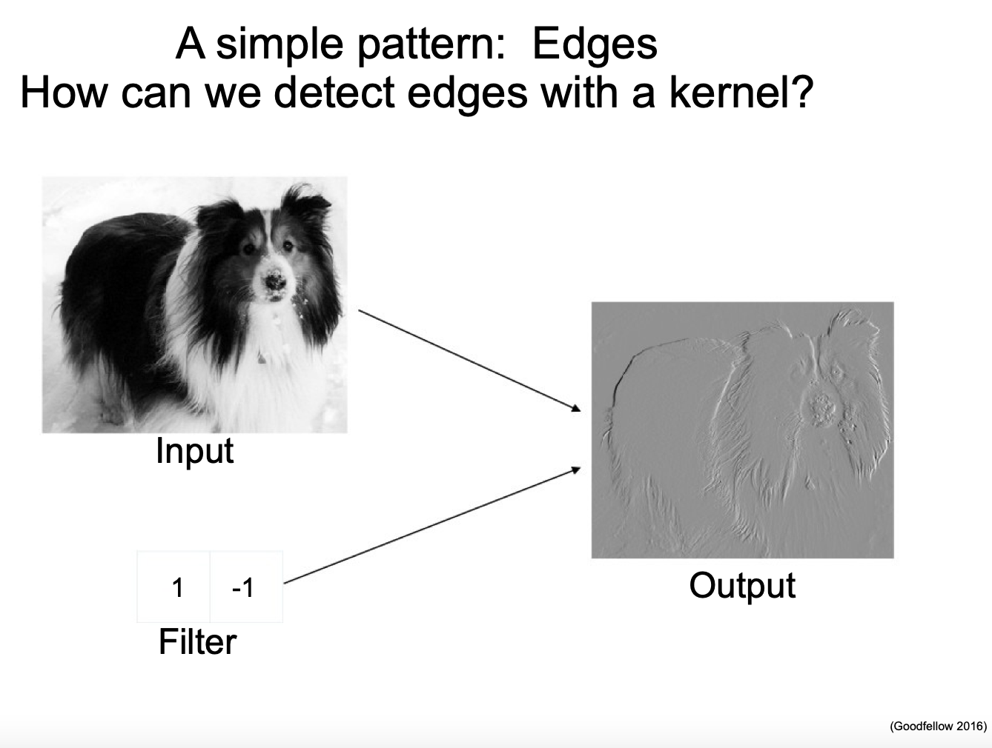
Edge Detection Filter

Slide 25
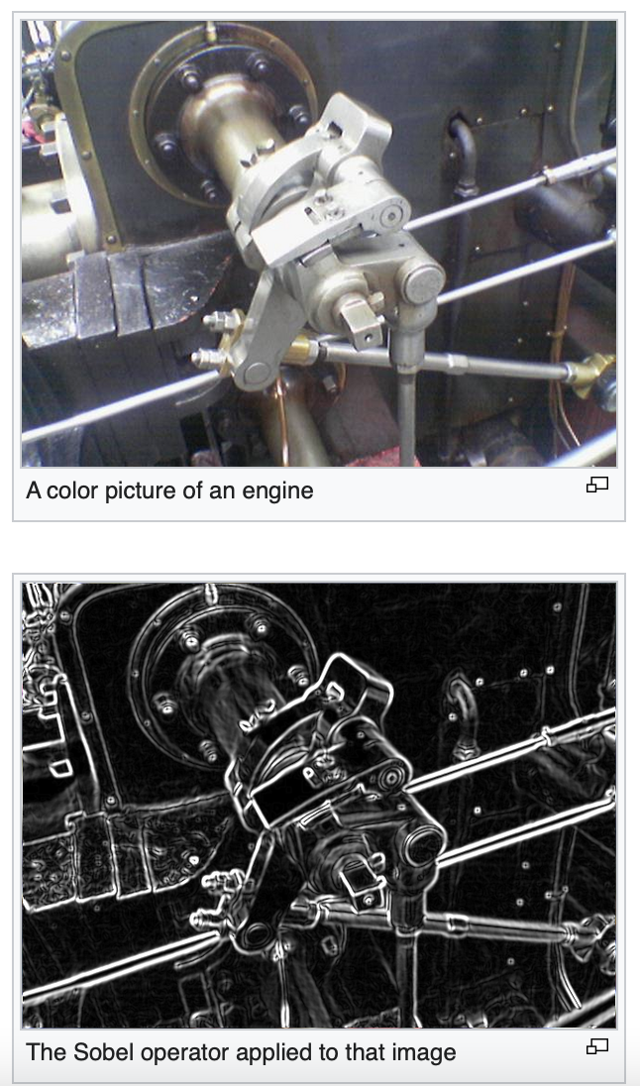
More sophisticated edge detection filter (Sobel Filter)
A pair of 3×3 convolution kernels (vertical/horizontal)
-1 | 0 | +1
-2 | 0 | +2
-1 | 0 | +1
1 | 2 | 1
0 | 0 | 0
-1 | -2 | -1
Source: Wikipedia

Slide 26
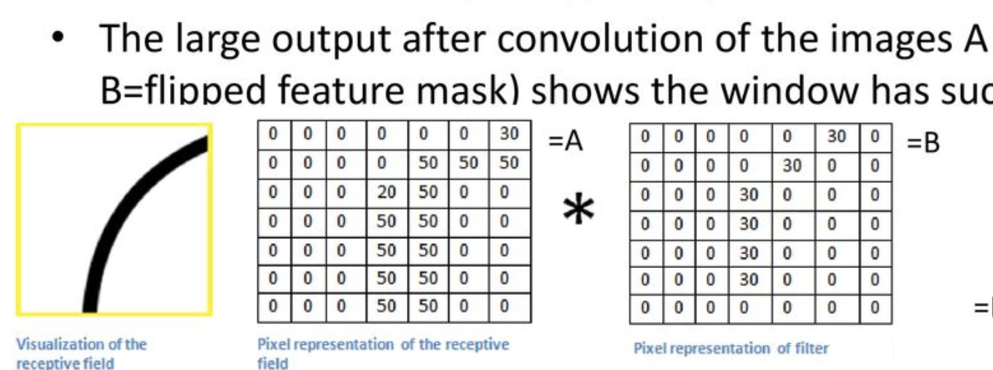

Slide 27
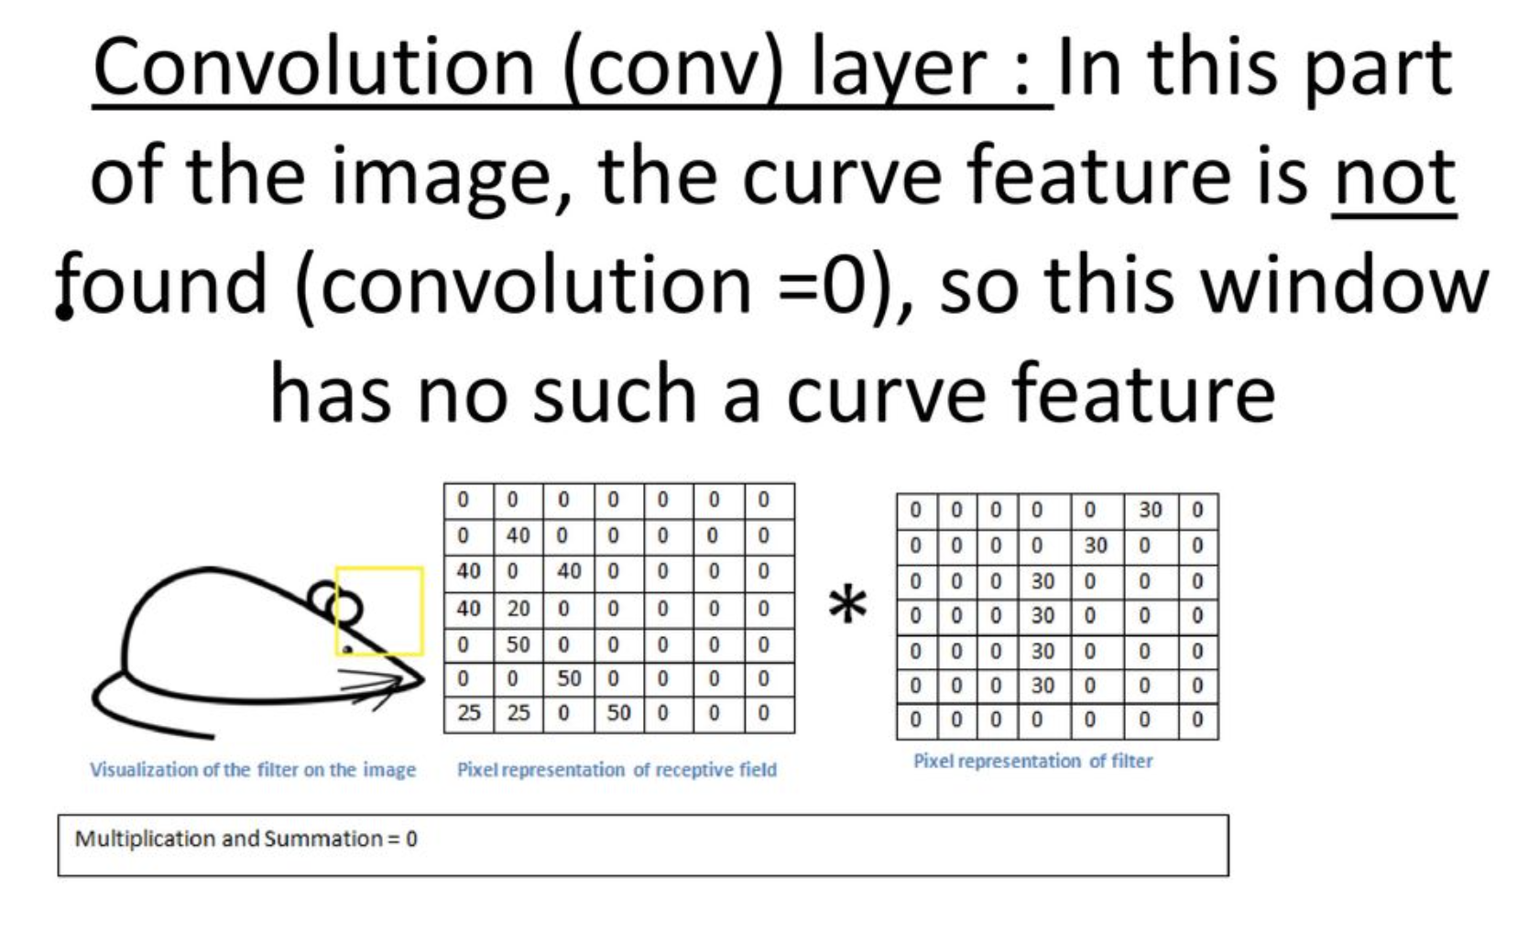

Slide 28
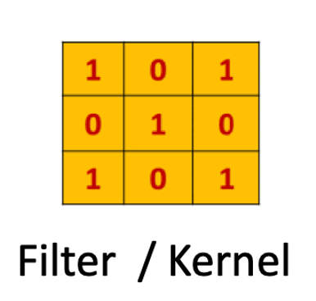
In a neural network, a filter (also known as a kernel) is a small matrix composed of some weights/values.
Responsible for feature extraction and pattern recognition from the input data.
They slide over the input data, performing element-wise multiplications and summing up the results to produce feature maps.
In Neural Network, The filter values are learned during the training process instead of setting them manually

Slide 29
Filters are not connected to the entire input; they are applied locally to small regions of the input, capturing specific patterns or features.
Filters have learnable parameters that are adjusted during training to optimize the network's performance.
We can extract different features from the input data by using different filters with different values.
For example, a filter that detects horizontal edges might have values like: This filter will highlight areas in the input data where there is a strong horizontal edge.
Convolutional Neural Networks (CNNs) utilize filters as a fundamental building block for various tasks in computer vision, such as image classification, object detection, and image segmentation.

Slide 30
Convolution
These are the network parameters to be learned.
1 | -1 | -1
-1 | 1 | -1
-1 | -1 | 1
1 | 0 | 0 | 0 | 0 | 1
0 | 1 | 0 | 0 | 1 | 0
0 | 0 | 1 | 1 | 0 | 0
1 | 0 | 0 | 0 | 1 | 0
0 | 1 | 0 | 0 | 1 | 0
0 | 0 | 1 | 0 | 1 | 0
Filter 1
-1 | 1 | -1
-1 | 1 | -1
-1 | 1 | -1
Filter 2
……
6 x 6 image
Each filter detects a small pattern (3 x 3).

Slide 31
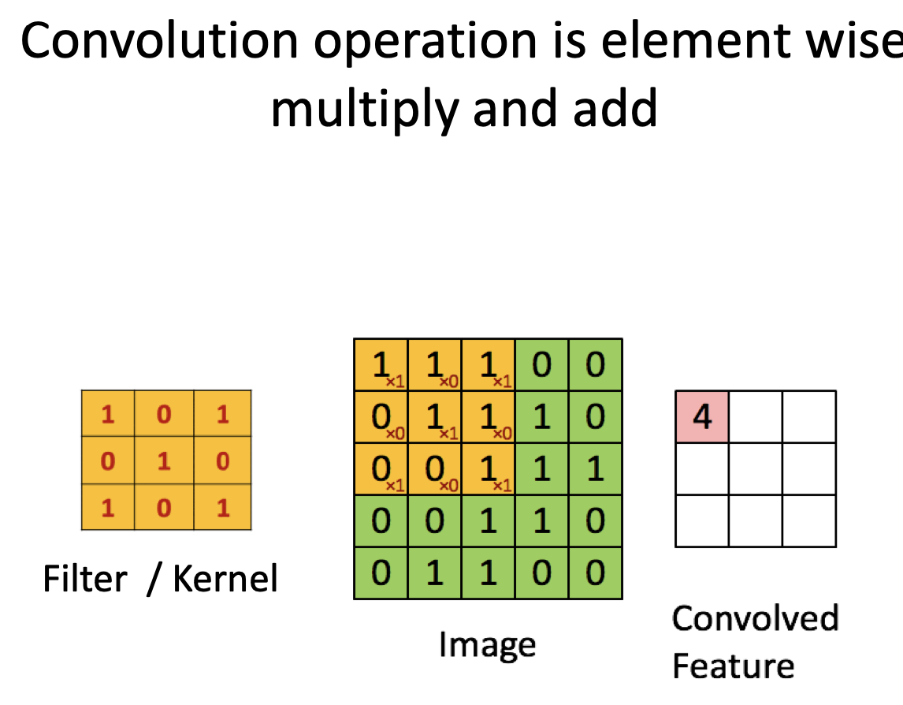

Slide 32
Sliding Window
The sliding window technique involves systematically moving a small window (i.e., filter or kernel) across an input, typically an image, to perform operations like convolution, or feature extraction at different spatial locations.
The window is systematically moved across the input data in a grid-like fashion. The movement can be defined by a specific stride, which determines how much the window shifts from one position to the next.
At each position of the window, an operation is performed. In the case of a CNN, this operation is usually convolution, where the filter is applied to the input data within the window, element-wise multiplication is performed, and the results are summed to produce an output value.

Slide 33
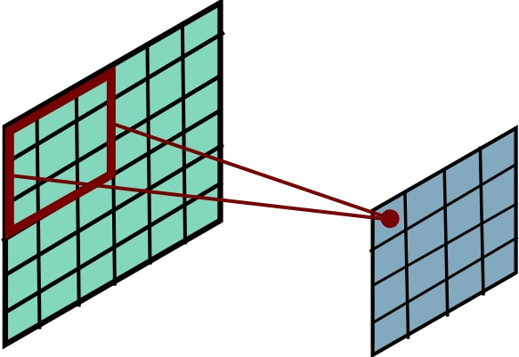
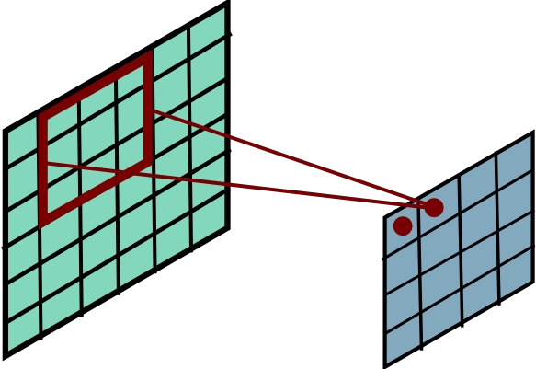
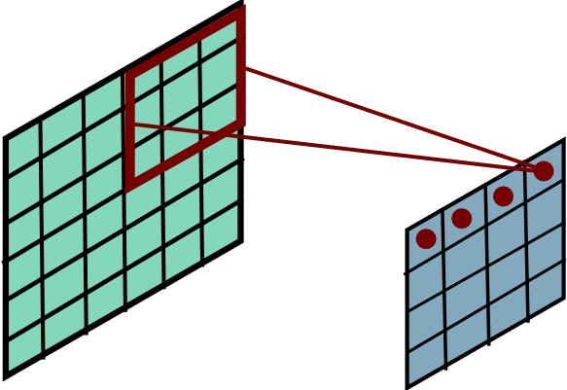
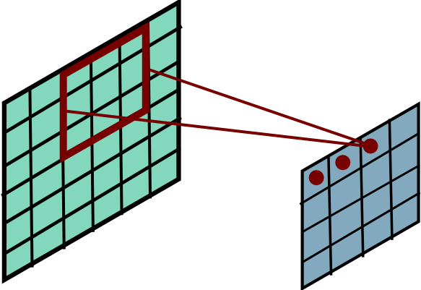
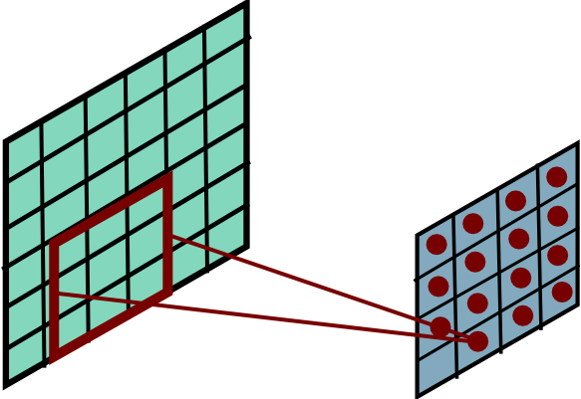
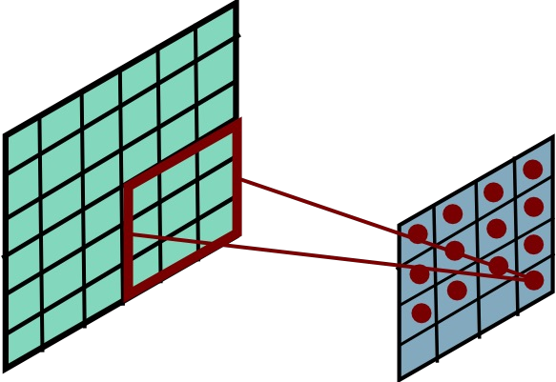
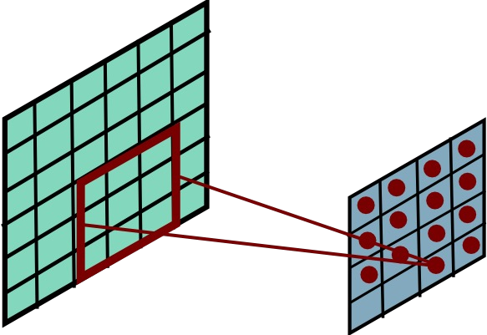
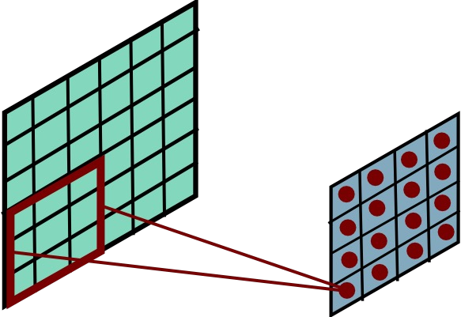
Sliding window convolution
(C) Dhruv Batra
Slide Credit: Marc'Aurelio Ranzato

Slide 34
Feature Map
The output of a filter applied to an image is commonly referred to as a feature map or activation map.
When a filter (also known as a kernel) is convolved with an input image in a Convolutional Neural Network (CNN) or a similar context, it generates a feature map.
A feature map is the output of a convolutional layer representing specific features in the input image or feature map.

Slide 35
Class Quiz: What will the output feature map be if you use a stride of 1?
3 | 1 | -2 | -4 | -5
3 | -4 | 2 | 5 | -1
-5 | 4 | 3 | -2 | -4
1 | -3 | 0 | 5 | 2
0 | -5 | 4 | -1 | 3
-1 | 0 | 1
-2 | 0 | 2
-1 | 0 | 1
=
*
Filter
Image

Slide 36
How stride size impact the size of feature map?
I be the input size (i.e., the height and width of the input image).
F be the filter size (i.e., the height and width of the convolutional filter).
S be the stride size
Output size: O = [(I - F) / S] + 1
- lets, we have an input image with a size of 7x7 pixels , and we apply a 3x3 filter with a stride of 2 (S = 2).
O = [(7 - 3) / 2] + 1 O = [4 / 2] + 1 O = 2 + 1 O = 3
So, with a stride of 2, the output size will be 3x3.
* We did not assume any padding in the input image - Valid (Zero Padding):

Slide 37
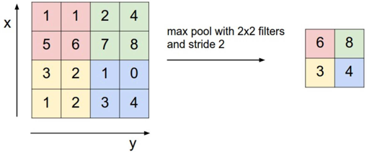
Max Pooling
Reduced dimensionality
Spatial invariance
Max Pooling, average pooling

Slide 38
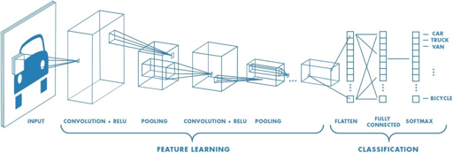
CNNs for Classification: Feature Learning
₉1
Learn features in input image through convolution
Introduce non-linearity through activation function (real-world data is non-linear!)
Reduce dimensionality and preserve spatial invariance with pooling

Slide 39
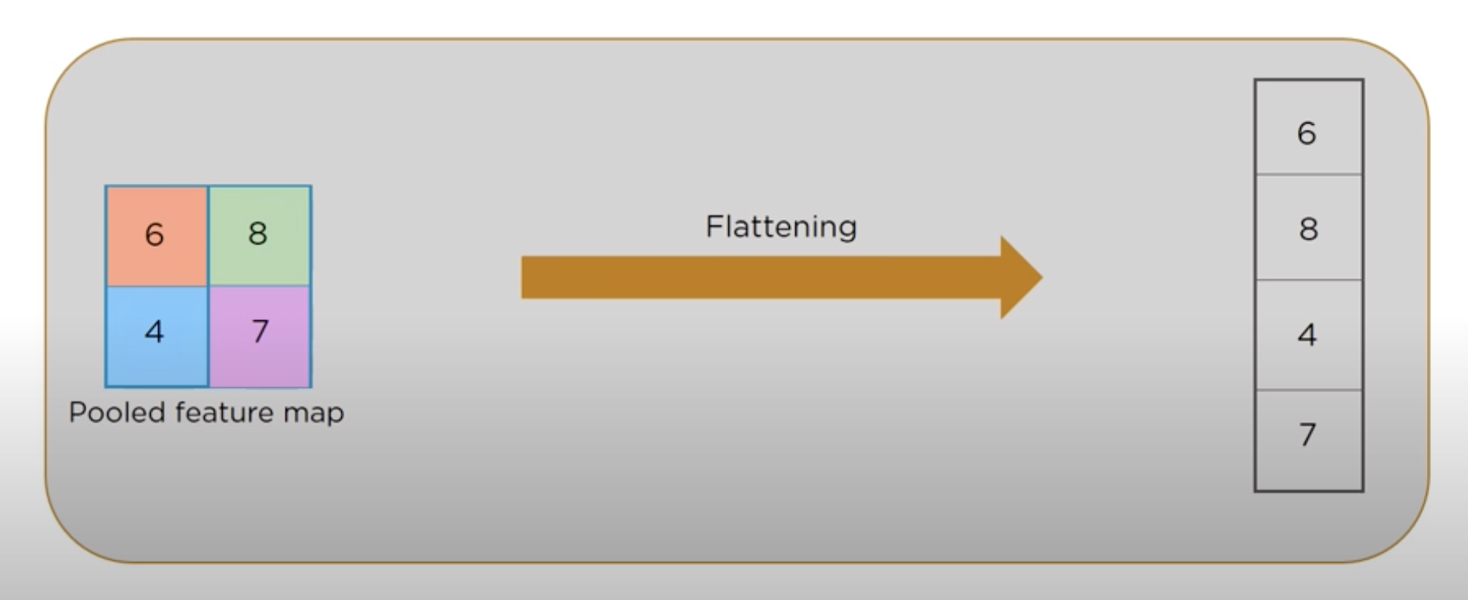
Flattening
Flattening is a critical step in transitioning from the spatially structured information in the feature maps to a format that can be processed by fully connected layers, which expect 1D vectors as input.

Slide 40
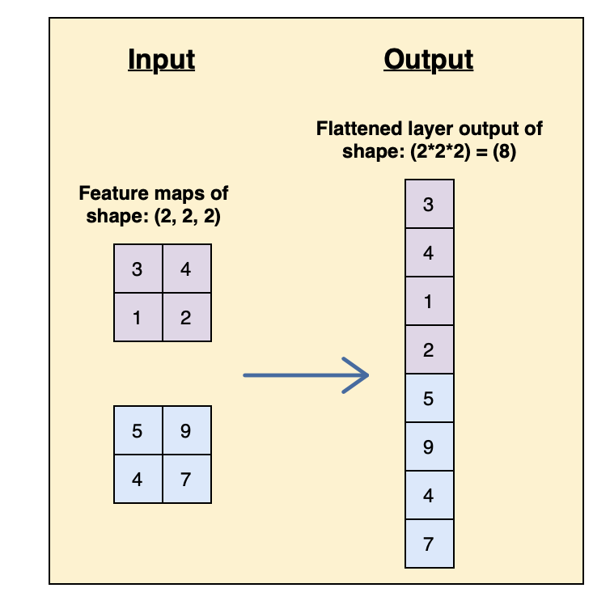

Slide 41
Fully Connected Layer
High-Level Feature Learning: Fully connected layers are responsible for learning high-level features and capturing complex relationships in the data. These layers can combine information from various parts of the input and create non-linear transformations that are useful for solving complex problems.
Global Information: While convolutional layers are excellent at capturing local features and spatial hierarchies, fully connected layers operate on a global scale. They consider information from the entire feature map and can learn to recognize patterns that involve relationships between local features.

Slide 42
